Slide 1

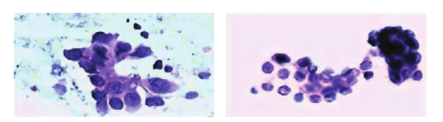
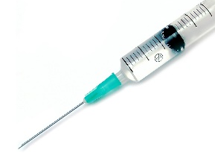

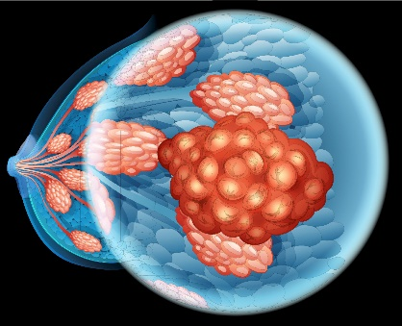
CANCER DIAGNOSIS PROCEDURE: OVERVIEW
TUMOR IMAGES
FEATURES
FINE NEEDLE ASPIRATE (FNA)
MALIGNANT
RADIUS
TEXTURE
PERIMETER
AREA
SMOOTHNESS
BENIGN
https://www.researchgate.net/publication/271907638_Breast_Cancer_Detection_with_Reduced_Feature_Set
https://plus.google.com/+Ehealthyblog

Slide 2
CANCER DIAGNOSIS PROCEDURE: DATASET IN MACHINE LEARNING TERMS
INPUT: 30 FEATURES
TARGET CLASS: 2
CLASSIFIER
MALIGNANT
RADIUS
TEXTURE
PERIMETER
AREA
SMOOTHNESS
BENIGN
Dataset:
Number of Instances: 569
Class Distribution: 212 Malignant, 357 Benign
Data source: https://archive.ics.uci.edu/ml/datasets/Breast+Cancer+Wisconsin+(Diagnostic)
https://www.researchgate.net/publication/271907638_Breast_Cancer_Detection_with_Reduced_Feature_Set

